Slide 1
Chapter 1: Getting Started
Fall 2023

Slide 2
General Information
Welcome to the Women In Nuclear (WIN) Python Workshop!
All content for this workshop can be found here (we will download at the end of this chapter): samwyss/purdue_win_python_workshop: A Python workshop given to members of Purdue's Women In Nuclear (WIN) chapter. (github.com)
All instructions will be conveyed in the form of PowerPoints for this chapter. After that, markdown (.md) files will be used to allow you to become more familiar with working in a text editor
If you have questions at any point, please let me know

Slide 3
Installing Python
As opposed to using an online platform to write code, we will walk you through the process of installing Python and a text editor on your local machine
It would be much faster for us to use services like Google Colab for this workshop; however, services like that make using what you learn here more difficult and convoluted in the future (especially when it comes to analyzing data in labs, doing homework, personal projects, etc.)

Slide 4
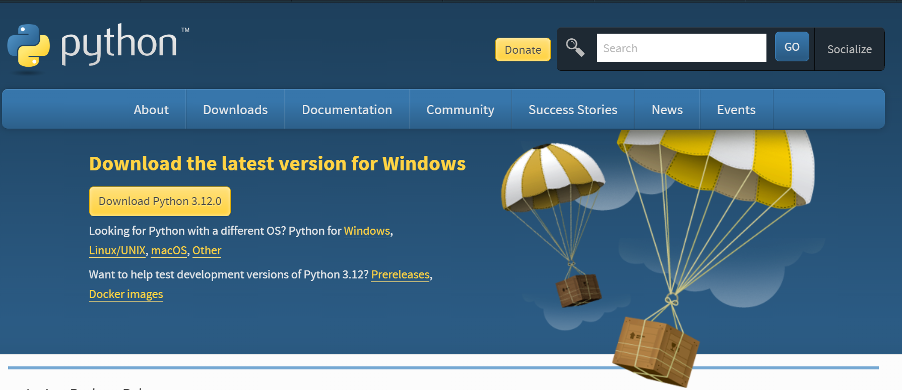
Installing Python
Go to the following link: Download Python | Python.org
Click on this

Slide 5
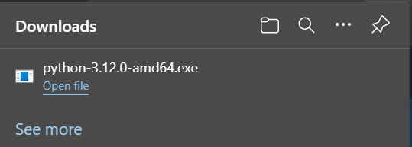
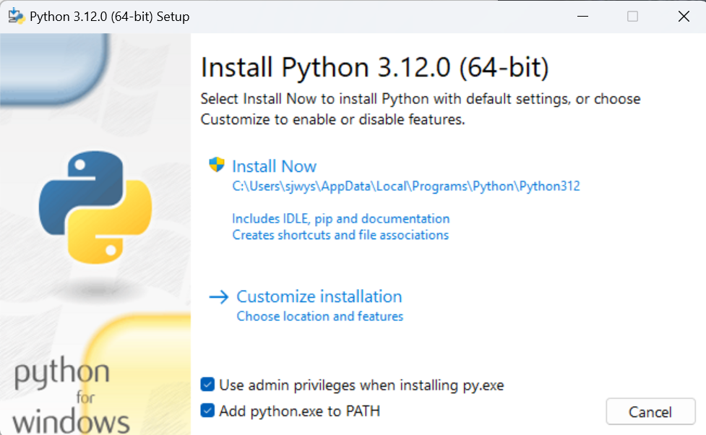
Installing Python
Save the file to your standard download location and then click “Open file” or “Run”
Click on “Add python.exe to path”
This allows us to run Python files from a terminal
Click “Install Now”
Allow the installer to make changes to your machine
Once finished, hit “close”

Slide 6
Installing VSCode
Python is now installed on your machine
To write Python files, we will use Visual Studio Code (VSCode), a free text editor from Microsoft
VSCode can be used to edit any text files
You can download VSCode here: Visual Studio Code - Code Editing. Redefined

Slide 7
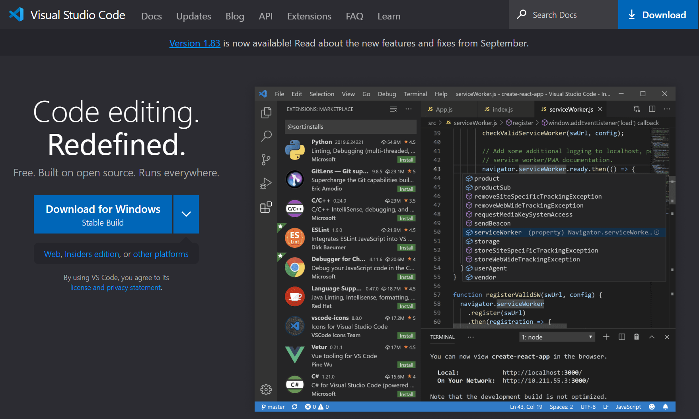
Installing VSCode
Click here to download the installer
Save to your preferred downloads folder and then run it

Slide 8
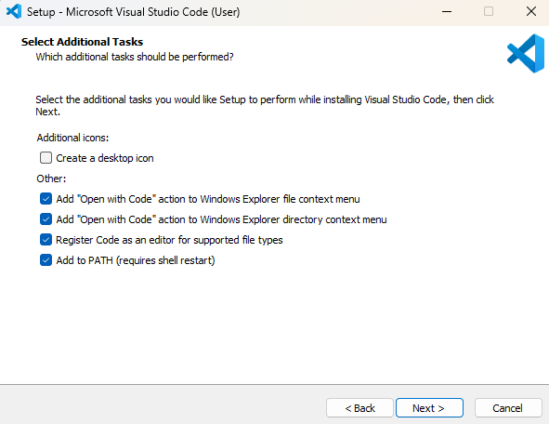
Installing VSCode
Accept the EULA
The default settings are fine as is
Click “Next” and then “Install”
Once finished installing, proceed to next slide

Slide 9
Restart Your Computer
Title
In order to finish setting up both of these applications, your computer needs to be restarted
Once back, proceed to the next slide

Slide 10
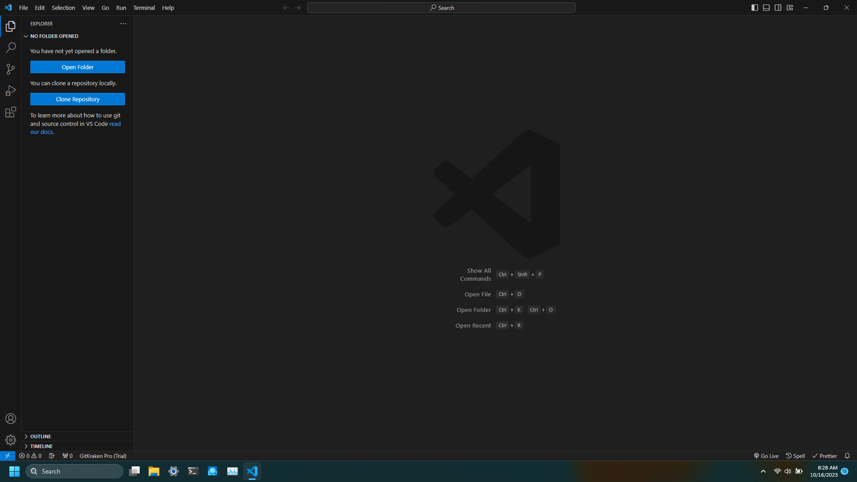
Opening The Workshop in VSCode
Click through the welcome screens for now
You can set up and personalize VSCode later (there are plenty of sources for this online)
We will go over the basics of VSCode in the next Chapter

Slide 11
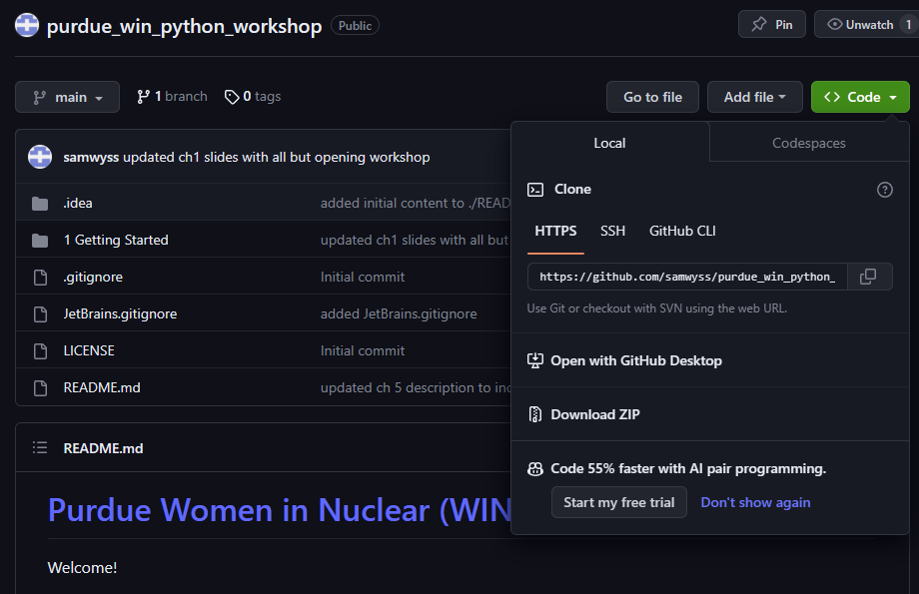
Opening The Workshop in VSCode
Click on the link to the workshop GitHub page (on slide 2)
Click “Code” then “Download ZIP”
Save to a known location, we will be working out of this folder
This workshop will not cover using Git
Once saved, navigate to this folder in your file explorer, right click, and then select “Extract All” or “Extract Here”

Slide 12
Opening The Workshop in VSCode
Next navigate back to your VSCode tab
Select “Open Folder”
Navigate to the unzipped folder and select it

Slide 13
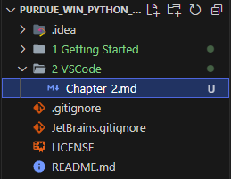
Opening The Workshop in VSCode
In the explorer tab, you should see something that looks like this
We will be working out of VSCode for the remainder of the workshop
To proceed to the next section double click on “Chapter_2.md” and then click the following icon in the top right of your screen to preview it

Slide 14
End of Chapter 1
Congratulations! You have finished Chapter 1. We will now learn a little bit about how to use VSCode and download some packages that are useful for writing Python

